Slide 1
09th DECEMBER 2025
OS-Evolve
Evolutionary framework for improving CPU Scheduling
Project presentation for CS395T: Adv. System for Gen AI
Krishanu Saini, Yoga Sri Varshan V
The University of Texas at Austin
Notes:
This is

Slide 2
Introduction
Handcrafted CPU scheduling algorithms take years to develop.
Linux CFS (2007)
What about these cases?
Best average case algorithm for generic workloads.
latency-sensitive schedulers?
throughput-optimized schedulers?
NUMA/topology-aware schedulers?
bursty/interactive workloads?
Datacenter with 1us tail-latency?
Kaffes, Kostis, et al. "Shinjuku: Preemptive Scheduling for {μsecond-scale} Tail Latency." 16th USENIX Symposium on Networked Systems Design and Implementation (NSDI 19). 2019.
Iyer, Rishabh, et al. "Achieving microsecond-scale tail latency efficiently with approximate optimal scheduling." Proceedings of the 29th Symposium on Operating Systems Principles. 2023.
Shinjuku¹
Concord²
Notes:
modifying a mature software like the linux system is a very painstaking task. and introduce a new algorithm for a task like CPU scheduling needs multifaceted and rigorous research covering many scenarios. Eventually this evolution takes a lot of time to come out - For example the Completely Fair Scheduler came out in October 2007 and hasn’t been changed ever since.
Recent research like Shinjuku and Concord - suggests bespoke scheduling policies can provide compelling performance results in a data center setting where tasks are repetitive and homogenous.

Slide 3

Automated Policy Evolution
Engineers handcraft logic for specific goals (Shinjuku for tail latency, Concord for microsecond scale)
Use Bayesian Optimization or ML to tweak existing parameters (changing time_slice from 3ms to 5ms)
Replace the scheduler with a Neural Network (Black Box problem)
Can we have a White Box Solution?
Use LLMs and Evolutionary Algos to rewrite the C++ Source Code itself - AlphaEvolve¹
Explore hundreds of code variations (mutations) that humans
Better algorithm (than Strassen’s algorithm) for Matrix Mul
Open Sourced Implementation - ShinkaEvolve²
Novikov, Alexander, et al. "AlphaEvolve: A coding agent for scientific and algorithmic discovery." arXiv preprint arXiv:2506.13131 (2025).
Lange, Robert Tjarko, Yuki Imajuku, and Edoardo Cetin. "Shinkaevolve: Towards open-ended and sample-efficient program evolution." arXiv preprint arXiv:2509.19349 (2025).

Slide 4
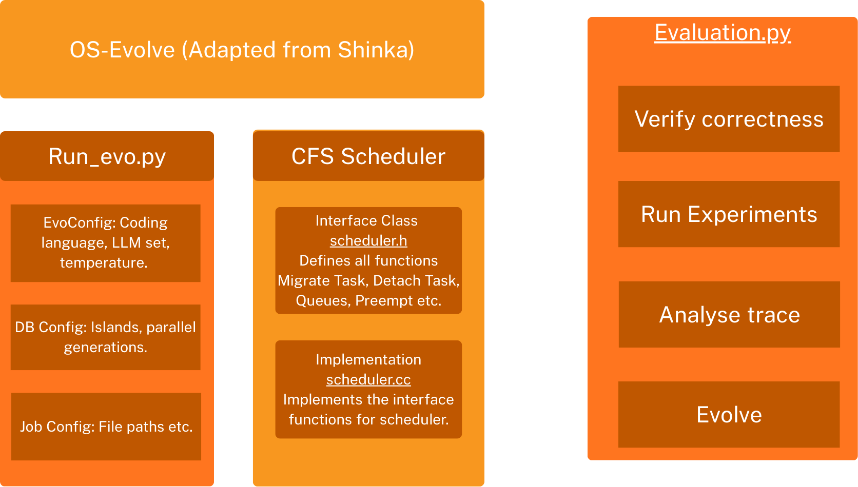
OS-Evolve
Notes:
Add references (names of methods/references/non-exhaustive list)

Slide 5
User Space CPU Scheduling
Ghost Framework¹
Userspace framework that lets developers implement and run custom CPU schedulers without modifying the Linux kernel.
Run ghost threads in agents
No frequent kernel modifications.
Humphries, Jack Tigar, et al. "ghost: Fast & flexible user-space delegation of linux scheduling." Proceedings of the ACM SIGOPS 28th Symposium on Operating Systems Principles. 2021.
Notes:
ghOSt (Google Hosted OS Tasks) is a userspace framework that lets developers implement and run custom CPU schedulers without modifying the Linux kernel. It offloads scheduling policy decisions to a userspace “agent,” while the kernel handles the low-level mechanics of context switching. This separation allows rapid experimentation with new scheduling algorithms, precise control over which CPUs use the custom scheduler, and detailed tracing of scheduling events — all while keeping the system stable and using an unmodified kernel.

Slide 6
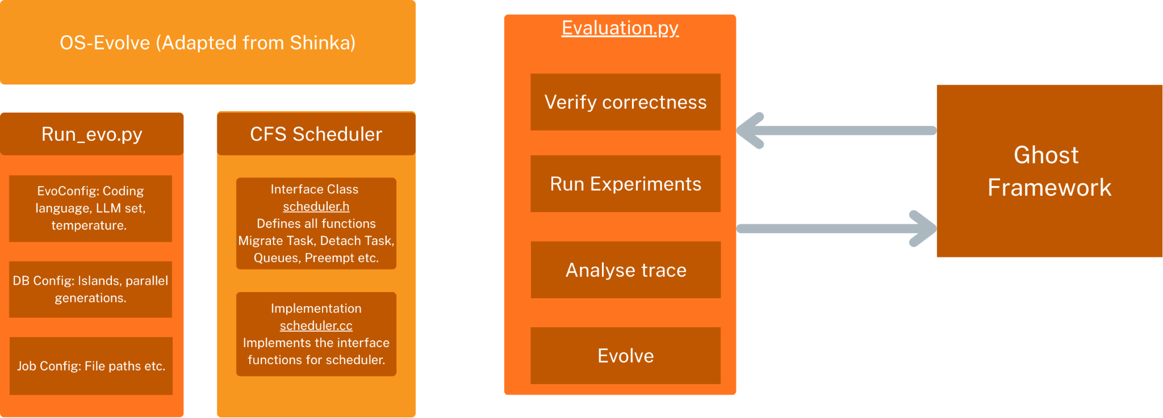
OS-Evolve
Notes:
We use the ghost framework as a replacement for modifying the kernel everytime.
For each SHinka evolution we spin up new agents and run certain benchmarks by migrating all threads of the processes to ghost agent.
We tap into the traces and we return the metrics needed by Shinka to evolve. These metrics include throughput, latency and SLO like p95 and p99.

Slide 7
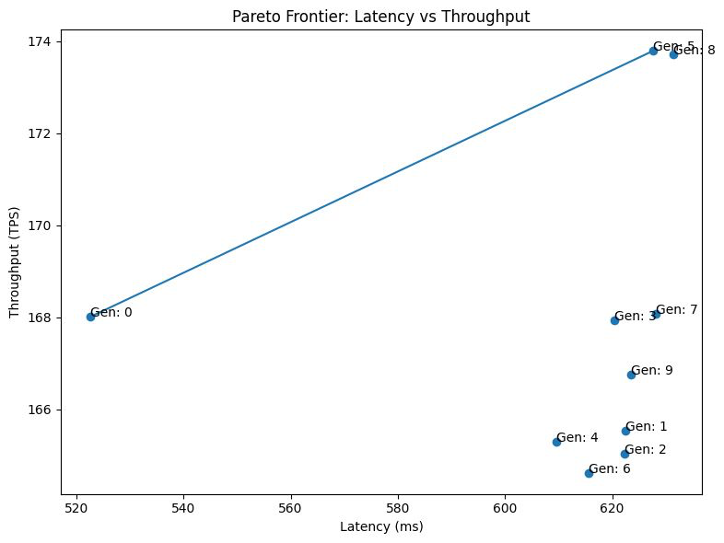
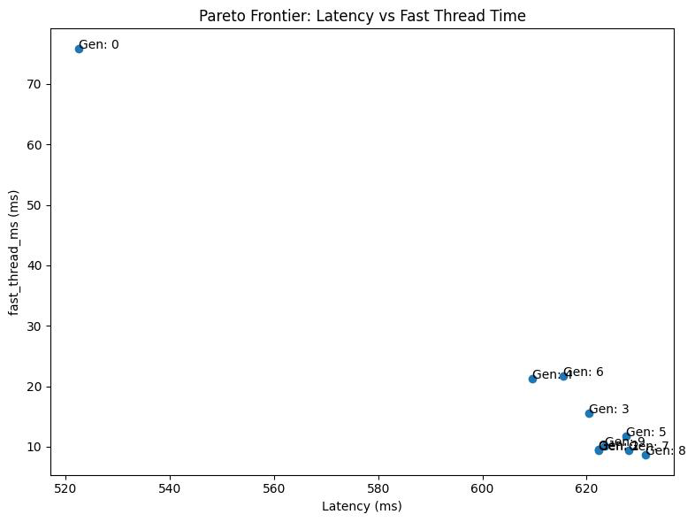
HoL test (Throughput/Latency Graph)
Notes:
This is our first benchmark dataset. This is a synthetic dataset made for testing head of line blocking,
it has a set of fast threads and slow threads that take up quite a lot of CPU burst time.
We now test the different generations of code evolved from OS Evolve
In the first image, we show a plot of the average latency, throughput.
We observe that Generation 5 and Generation 8 increase throughput but at the cost of latency.
This is interesting because the image on the right hand side shows that our generations are improving the latency of fast threads
but the slow threads are taking a toll.

Slide 8
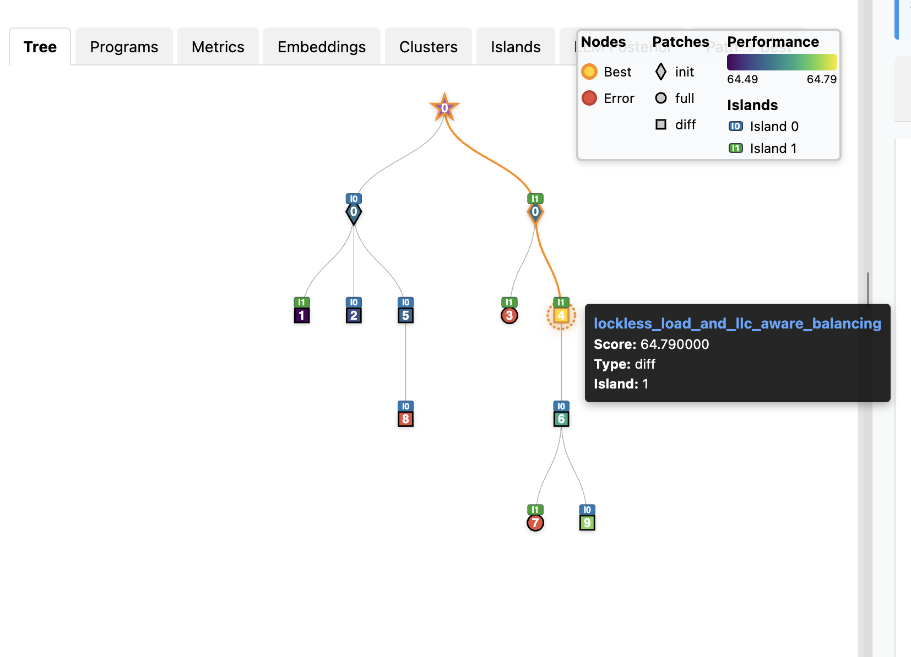
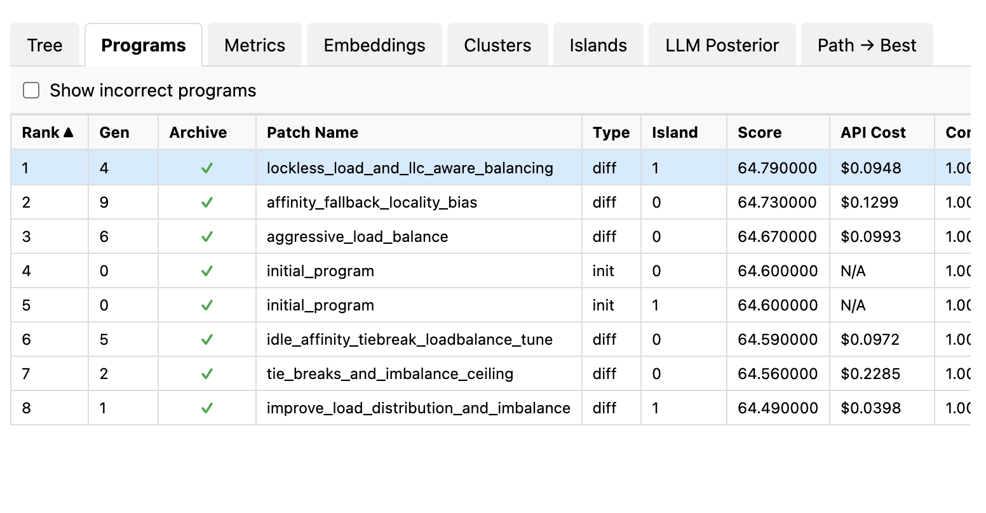
Viz graph
Notes:
This shows how one evolution run looks like. This tree like structure starts with the initial cfs al

Slide 9
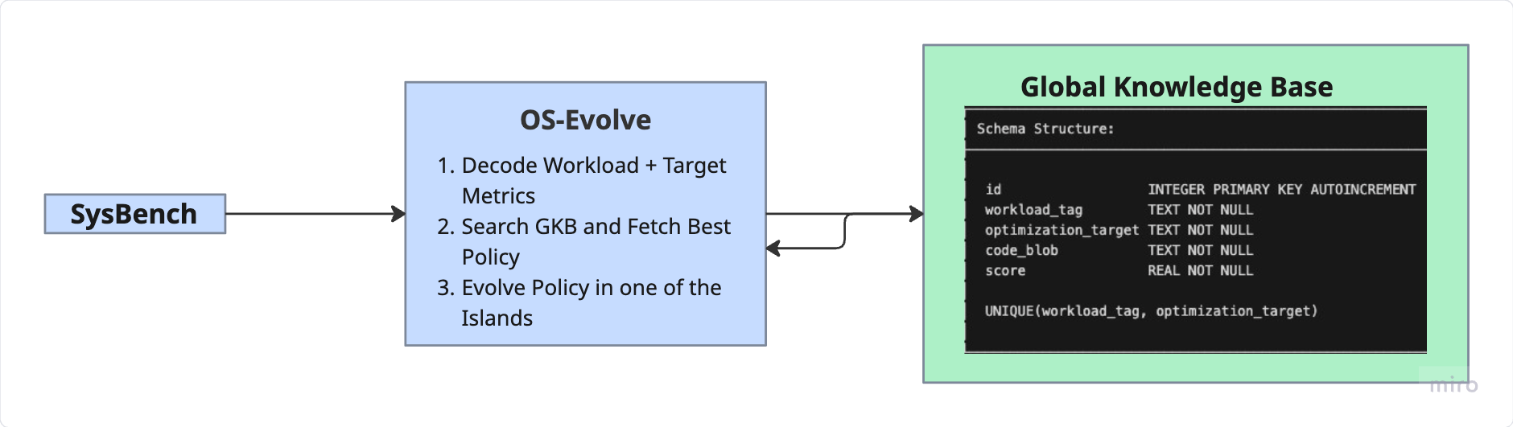
Global Knowledge Base
Re-discovering complex logic (e.g., L3 cache affinity) wastes CPU hours and evolutions
A centralized database acts as a permanent archive for high-performing policies
Optimizations discovered for one CPU-heavy task (Prime Number calc) are automatically transferred to accelerate learning for others (Scientific Computing)

Slide 10
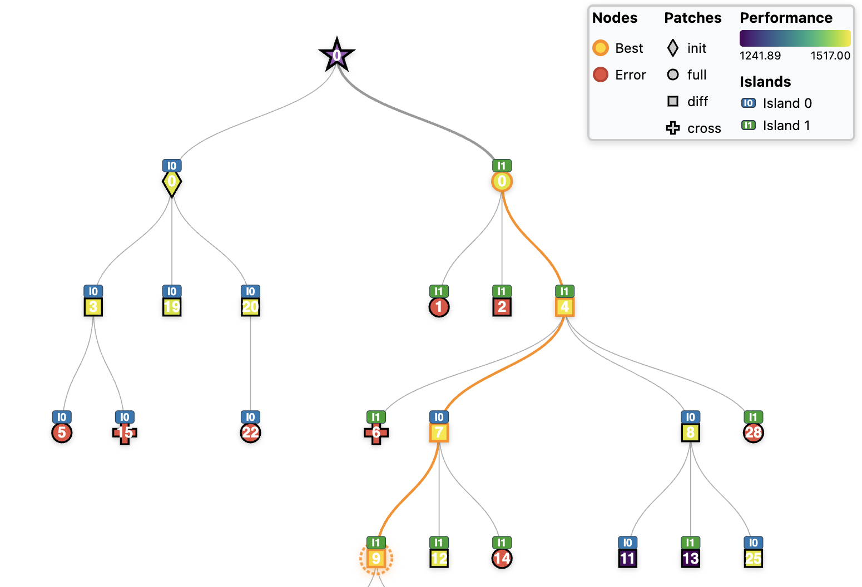
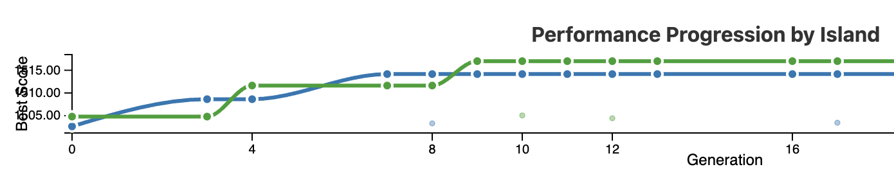
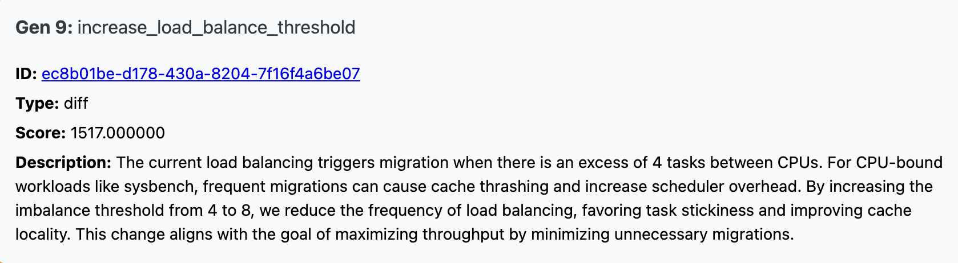
Island graph
Evolution Run 1:
  SysBench CPU workload with 64 threads, evolved program stored (1541 events/sec)
Evolution Run 2:
  SysBench CPU workload with 32 threads, I_0 → Initial CFS code, I_1 → Veteran code
I_0
I_1
Notes:
Our model tweaks the inference island code. on one side

Slide 11
Results
Busiest_queue_avg_deviation
Improve `FindBusiestQueue` to select the CPU with the maximum deviation above the average load, enabling more balanced migrations by targeting the most overloaded CPU relative to the cluster.
Metric | Baseline | New Algorithm | Explanation
Throughput | 168.00 ms | 173.72 ms ↑ | Selecting the CPU with the maximum run-queue length ignores the distribution of load across the cluster. The new algorithm tries to identify the true outlier.
Latency | 522.52 ms | 631.36 ms ↑ | It can leave moderately overloaded CPUs waiting longer for relief, increasing queueing delay and raising latency.
prefer_l3_sibling_affinity
Throughput: 173 ms ↑
Latency: 627 ms ↑
aggressive load balance
Throughput: 168.07 ms ↑
Latency: 628.16 ms ↑

Slide 12
Results
SysBenchCPU workload → tests a system's raw computational power by having threads calculate prime numbers up to 20,000
Num Threads | Num CPUs | Initial Score(Throughput) | Best Evolved Score
4 | 5 | 1234.56 | 1240.98
32 | 5 | 1504.8 | 1517.0
32 | 10 | 4621.63 | 4737.81
64 | 5 | 1502.34 | 1541.11

Slide 13
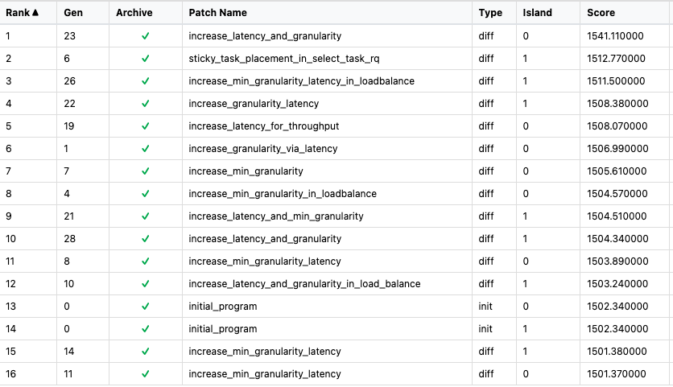
Results
SysBenchCPU workload with 64 threads
Gen23 combines aggressive parameter tuning with proven hierarchical placement to achieve peak performance
LoadBalance function includes a static initialization block that globally increases latency_ and min_granularity_, reducing preemption and improving cache retention.
This is layered on top of the established SelectTaskRq logic that checks current CPU, previous CPU, and L3 siblings - directly building on the successful pattern from Gen 6 and Gen 19.
The result is a 1541.11 events/sec throughput, surpassing all prior correct implementations.

Slide 14
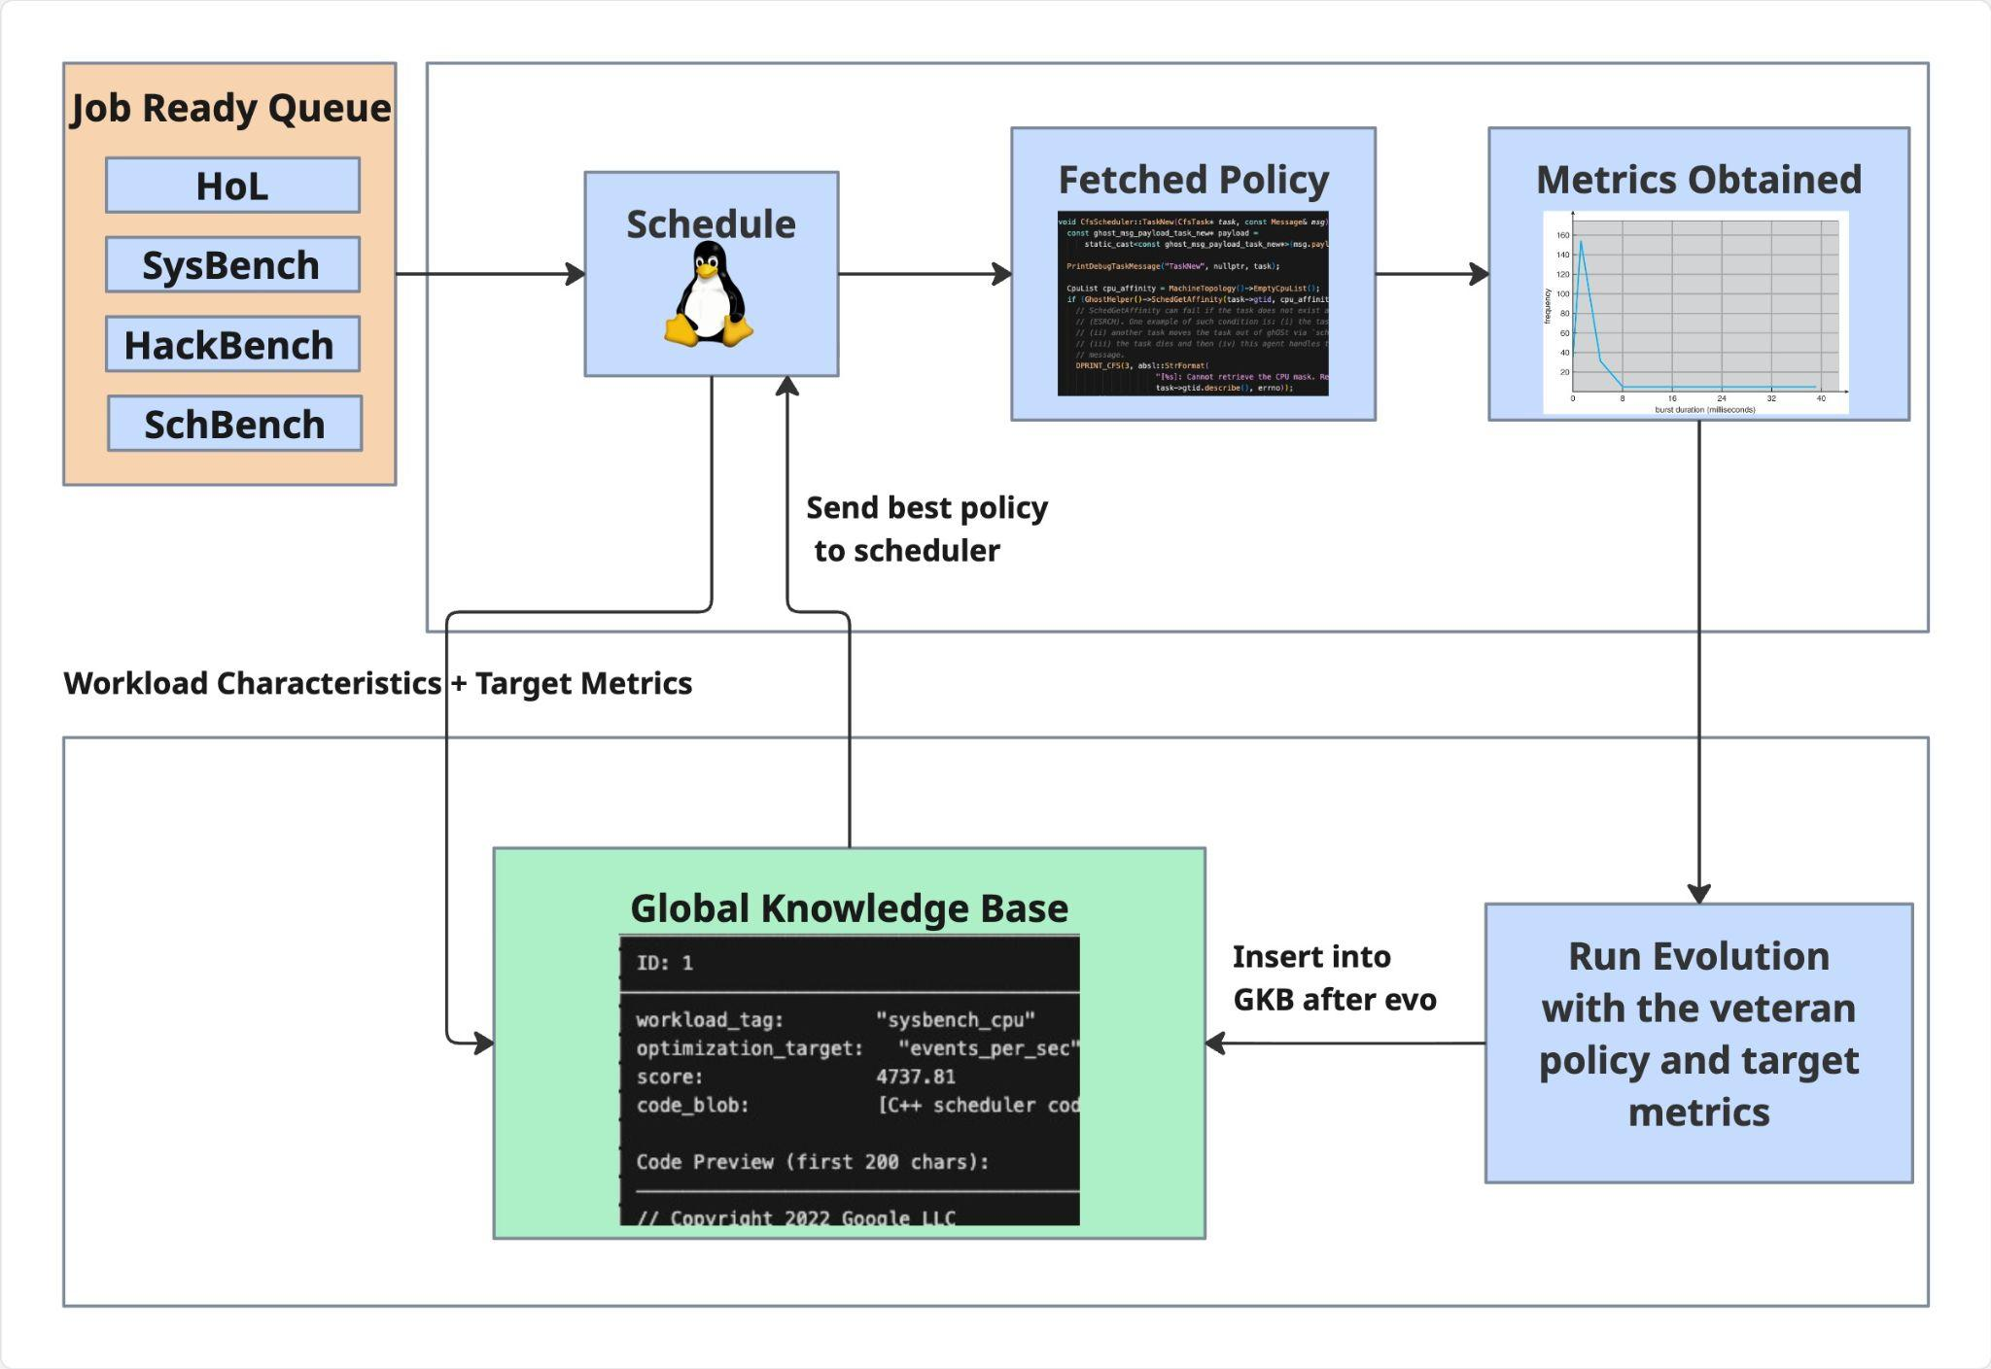
Proposal
Online
Core Idea
Decoupled Optimization Loop (Offline vs. Online)
Global Knowledge Base stores the best evolved code from past iterations indexed by workload_tag, optimization_target and other metrics.
Run Evolution → Insert into GKB creates a permanent improvement workflow
Offline

